Slide 1
Register Allocation by Puzzle Solving
Introduction:
Programs in a high level language are written under the assumption that an unbounded number of variables can be created to store values. Once these programs are translated into machine code, some of these variables will be stored in registers, while others will have to be stored in memory. It is advantageous to maximize the number of variables stored in registers, because reading or writing registers is faster than accessing memory. However, computer architectures only provide a small number of registers, and normally different variables cannot be simultaneously stored in registers.
In this paper we introduce a new abstraction: register allocation by puzzle solving. We model the register file as a puzzle board and the program variables as puzzle pieces. The result is a collection of puzzles with one puzzle per instruction in the intermediate representation of the source program. We will show that puzzles are easy to use, that we can solve them efficiently, and that they produce code that is competitive with the code produced by state-of-the-art algorithms.

Slide 2
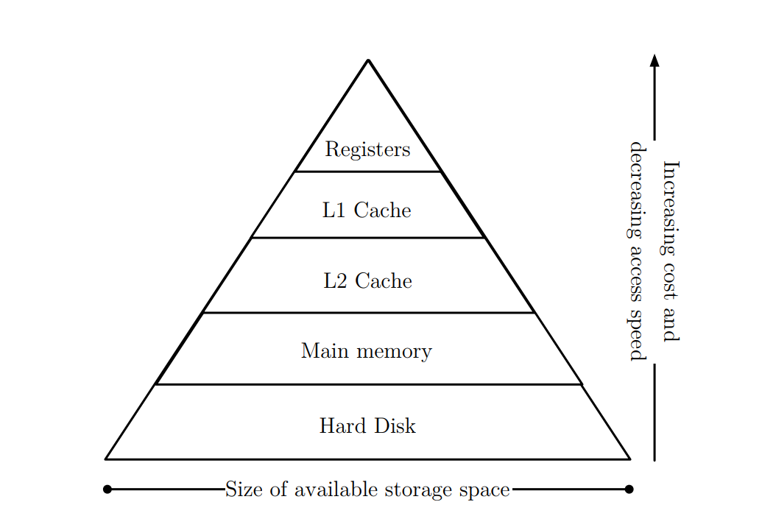
Background Work:
Computer architectures rely on a memory hierarchy to store the data that is manipulated by programs. Figure shows the storage pyramid that is typically observed on a ordinary computer. At the very top of the pyramid we have registers, which provide to the CPU the fastest access to data. Because registers are so fast and so few, one of the greatest challenges of compiler writers is to design algorithms that keep the most used program variables in registers, while relegating the least used variables to memory if necessary. Register allocation is thus the problem of mapping variables to registers or memory.

Slide 3
The research that constitutes this dissertation started in the Winter of 2005. Register allocation has a very intimate relation with graph coloring, and chordal graphs can be colored in time linear on the number of edges. This observation motivated our first paper on this field: Register Allocation via Coloring of Chordal Graphs One year after this first publication we released our second paper on this subject: Register Allocation After Classical SSA Elimination is NP-Complete Finally, on the Spring of 2008 we released our most important result: Register Allocation by Puzzle Solving, published in The Conference on Programming Language Design and Implementation In addition of these three papers, While implementing our register allocators, we have developed a technique to perform the translation validation of register allocation outputs. Register allocation by puzzle solving is feasible and effective for most computer architectures currently in use.

Slide 4
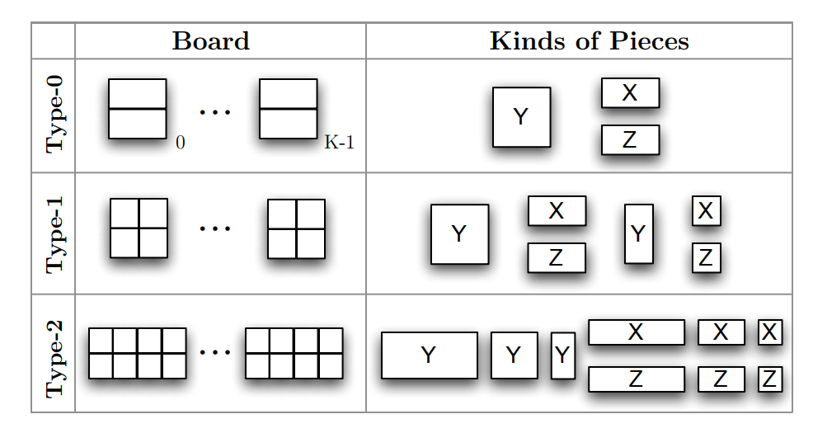
Work Approach:
We have implemented a puzzle-based register allocator. Our register allocator has four steps: 1. transform the program into an elementary program by augmenting it with φ-functions, π-functions and parallel copies 2. transform the elementary program into a collection of puzzles 3. do puzzle solving, spilling, and coalescing and finally 4. transform the elementary program and the register allocation result into assembly code.
A puzzle consists of a board and a set of pieces. Pieces cannot overlap on the board, and a subset of the pieces are already placed on the board. The challenge is to fit the remaining pieces on the board.

Slide 5
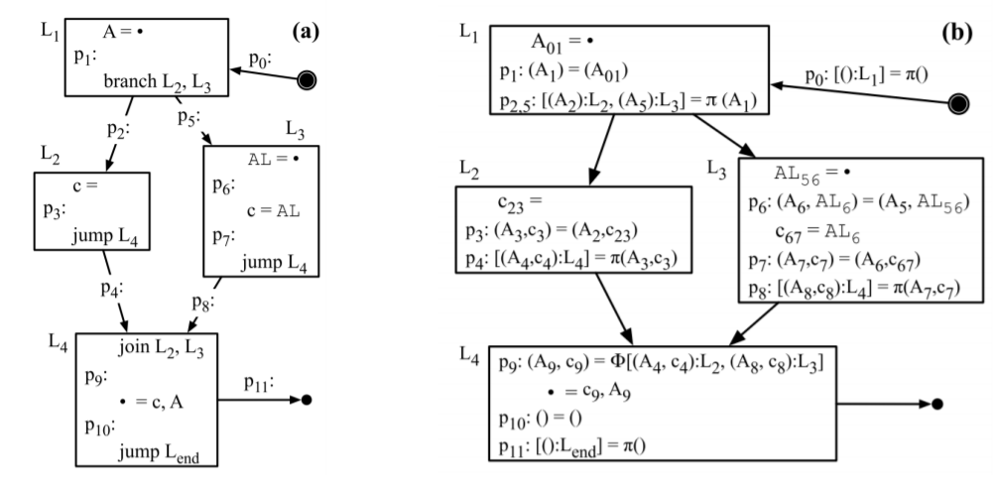
From a program to puzzle pieces:
1. Convert a program into an elementary program
A. Transform code into SSA form
B. Transform A into SSI form
C. Insert in B parallel copies between every instruction pair
2. Map the elementary program into puzzle pieces.
original program elementary program

Slide 6
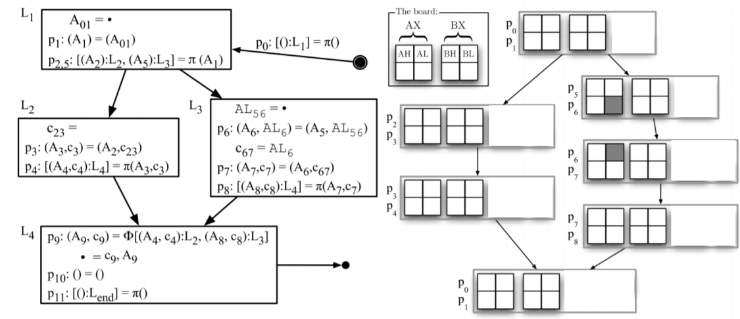
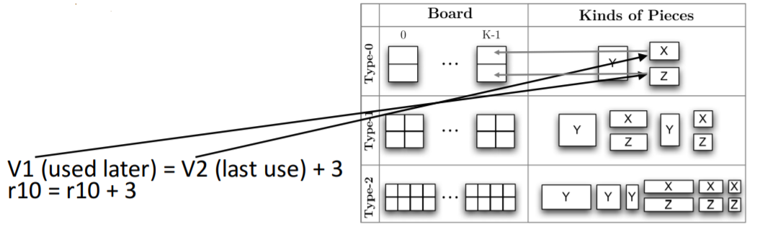
Add puzzle boards
Generating puzzle pieces
For each instruction i
- Create one puzzle piece for each live-in and live-out variable
- If the live range ends at i, then the puzzle piece is X
- If the live range begins at i, then Z-piece
- Otherwise Y-piece

Slide 7
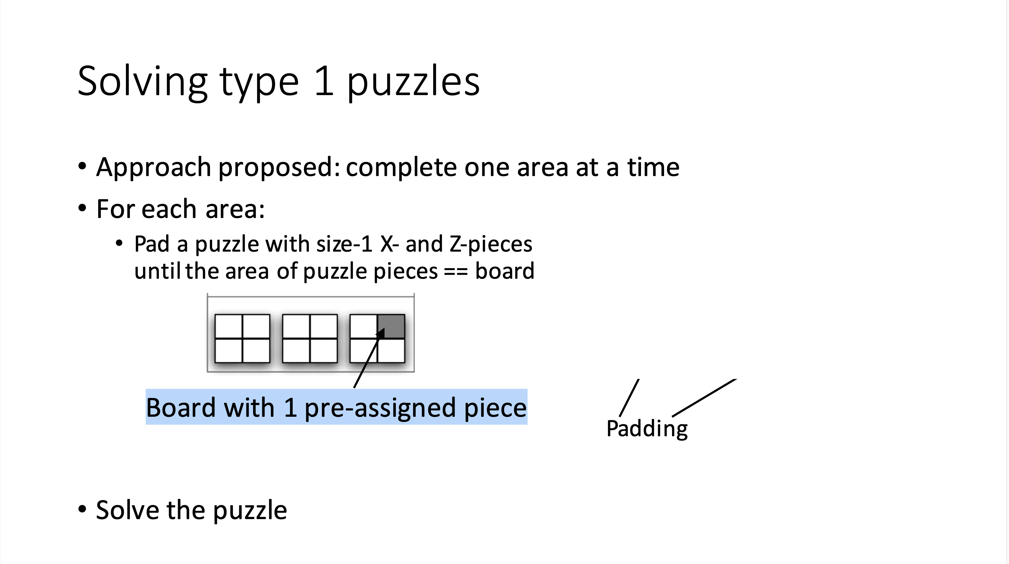
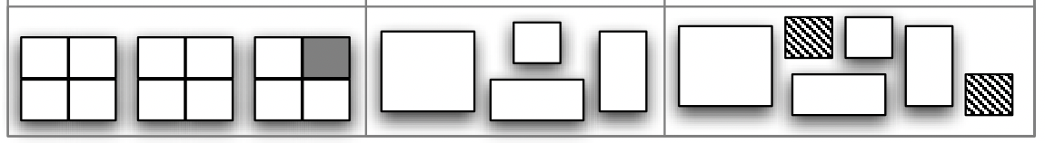
Solving type 1 puzzles
Approach proposed: complete one area at a time
• For each area:
- Pad a puzzle with size-1 X- and Z-pieces until the area of puzzle pieces == board

Slide 8
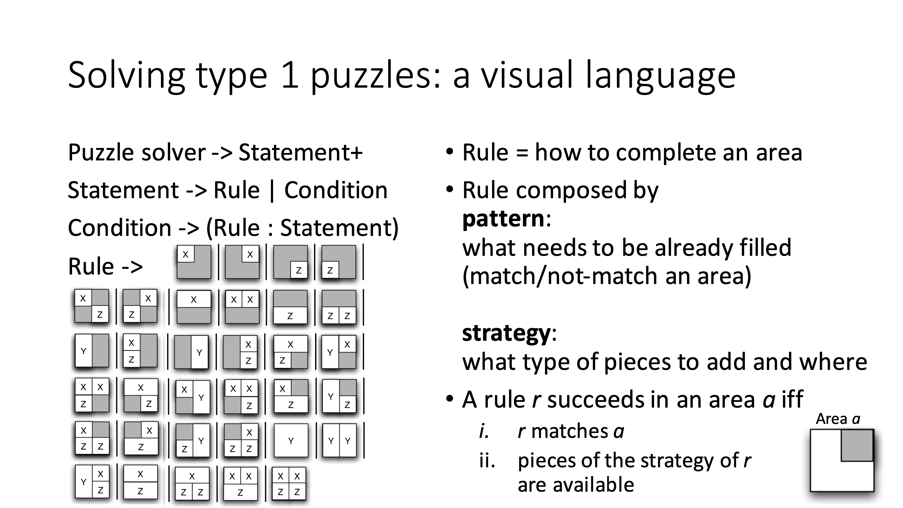

Slide 9
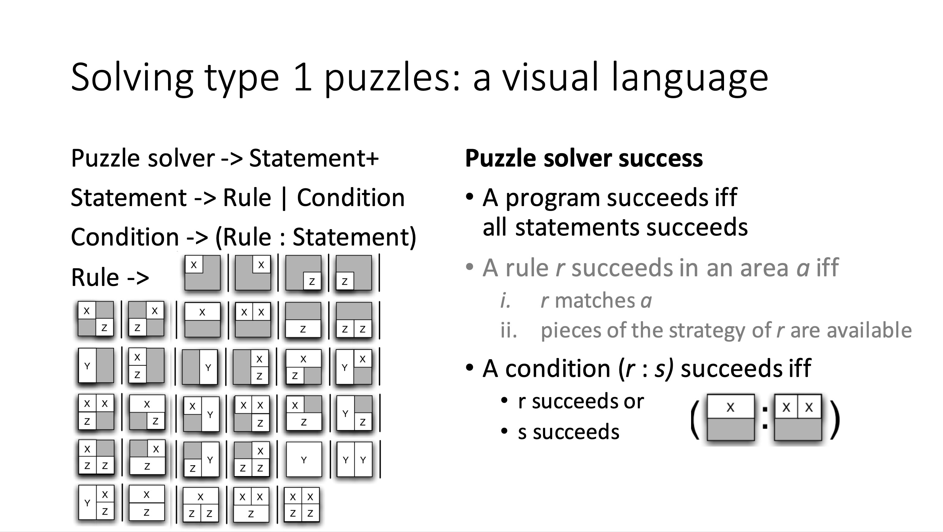

Slide 10
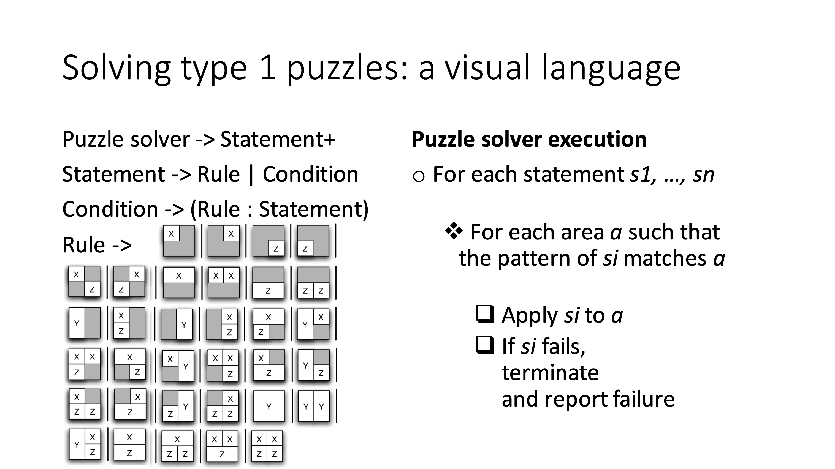

Slide 11
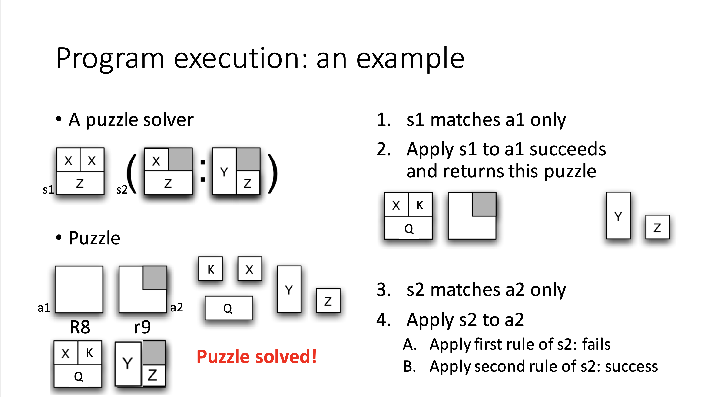

Slide 12
Conclusion:
In this paper we have introduced register allocation by puzzle solving. We have shown that our puzzle-based allocator runs as fast as the algorithm used in an industrial-strength JIT compiler and that it produces code that is competitive with state-of-the-art algorithms. A compiler writer can model a register file as a puzzle board, and straightforwardly transform a source program into elementary form and then into puzzle pieces. For a compiler that already uses SSA form as an intermediate representation, the extra step to elementary form is small. Our puzzle solver works for architectures such as x86, ARM, and PowerPC. Puzzle solving for SPARC V8 and V9 (type-2 puzzles) remains an open problem. Our puzzle solver produces competitive code even though we use simple approaches to spilling and coalescing. We speculate that if compiler writers implement a puzzle solver with advanced approaches to spilling and coalescing, then the produced code will be even better.

Slide 13
Reference
Scott Ananian. The static single information form. Master’s thesis, MIT, September 1999.
Andrew W. Appel and Lal George. Optimal spilling for CISC machines with few registers. In PLDI, pages 243–253. ACM Press, 2001.
L. Belady. A study of the replacement of algorithms of a virtual storage computer. IBM System Journal, 5:78–101, 1966.
https://llvm.org/pubs/2008-06-PLDI-PuzzleSolving.pdf
https://en.wikipedia.org/wiki/Register_allocation
http://homepages.dcc.ufmg.br/~fernando/publications/papers/PhdDiss.pdf

